Slide 1
Primary Care Networks (PCNs)
PCNs are based on neighbouring GP practices that work together typically covering 30-50,000 people
GP contract changes will allow GP practices in a local area to enter into a ‘network contract’ which is an extension to their current contract
Funds will be designated to ‘flow’ through these new network contracts
CCG enhanced services contracts to be part of network contract

Slide 2
Why Primary Care Networks?
Improving health and care outcomes – encouraging proper communities of care and ensuring practices are at the heart of neighbourhood teams
Investment – economies of scale and streamlining existing structures and functions
Workforce – working at scale enables resilience and changes to skill mix and roles that may not make sense or be viable for smaller practices

Slide 3
What will they do?
Extended hours (evening and weekends)
Quality Improvement Indicators (end of life care and prescribing safety)
Population health analytics
Workforce planning
Collaboration across services
Patient engagement
Notes:
Extended hours – 75% nationally. All patients in PCN to have access to extended hours.
Prescribing – emphasis on appropriate medications for appropriate medications
EOL care – time to support people as they reach the end of life; working with peers to make sure you are all trained and skilled in EOL care (difficult conversations)
Population health – risk stratification
Workforce – clinical pharmacists and social prescribers. Then physio, physicians associate, paramedics
Patient engagement – good in Fareham and Gosport and will continue this across a wider PCN level / consistent messages

Slide 4
The PCN areas for Fareham and Gosport

Slide 5
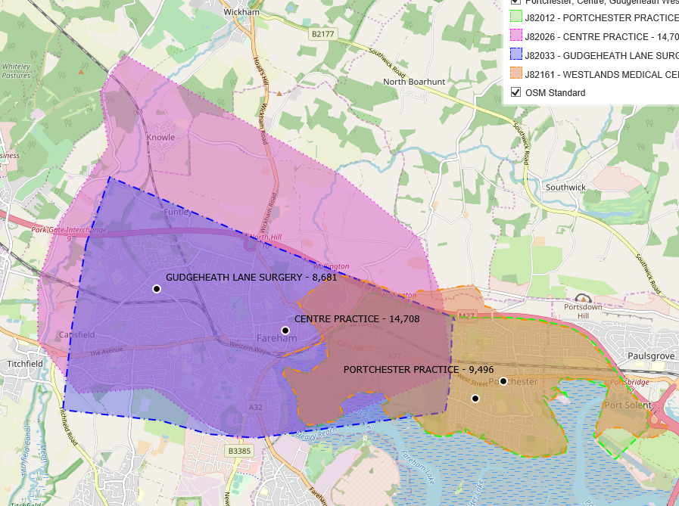
Fareham Central PCN
Portchester Practice
Westlands Medical Centre
Centre Practice
Gudgeheath Lane Surgery
Total list size: 43,389

Slide 6
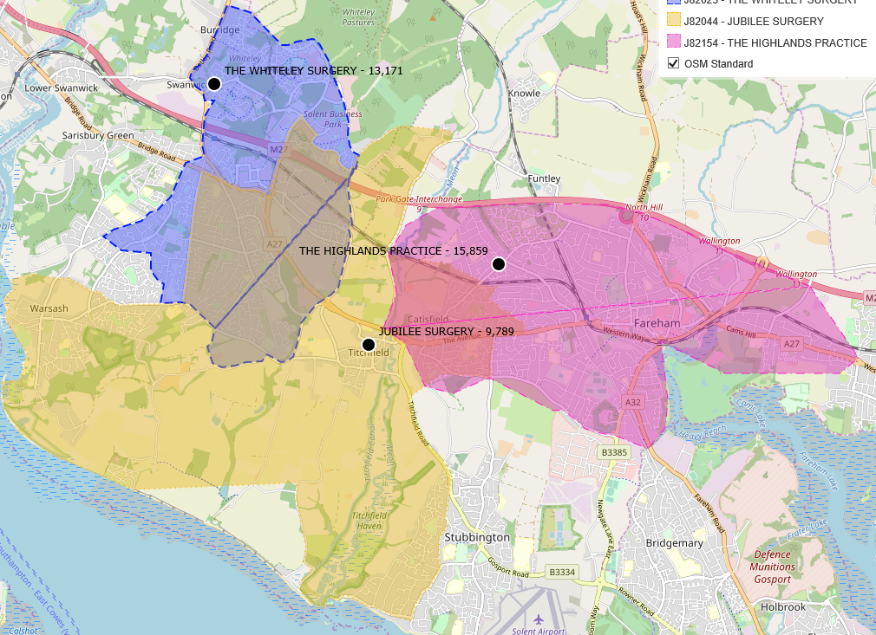
Sovereign PCN
Highlands Surgery
Whiteley Surgery
Jubilee Surgery
Total list size: 38,819

Slide 7
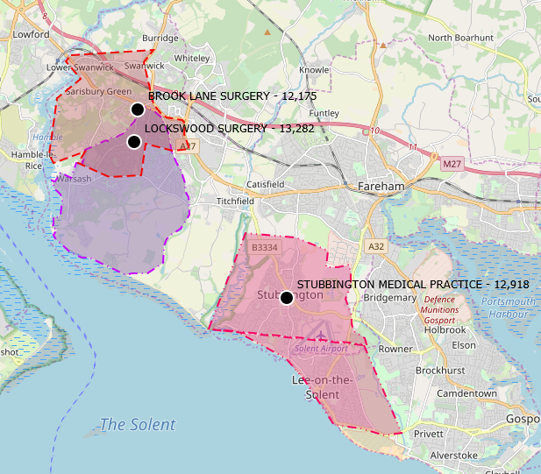
Fareham Coastal PCN
Brook Lane Surgery
Lockswood Surgery
Stubbington Medical Practice
Total list size: 38,375

Slide 8
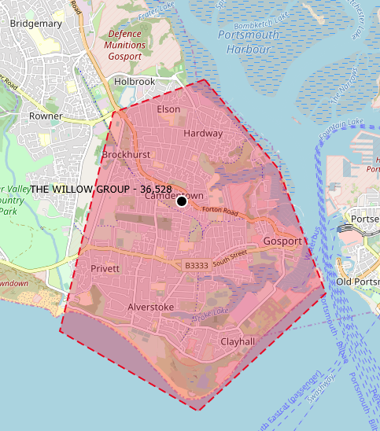
Gosport Central PCN
The Willow Group
Total list size: 36,528

Slide 9
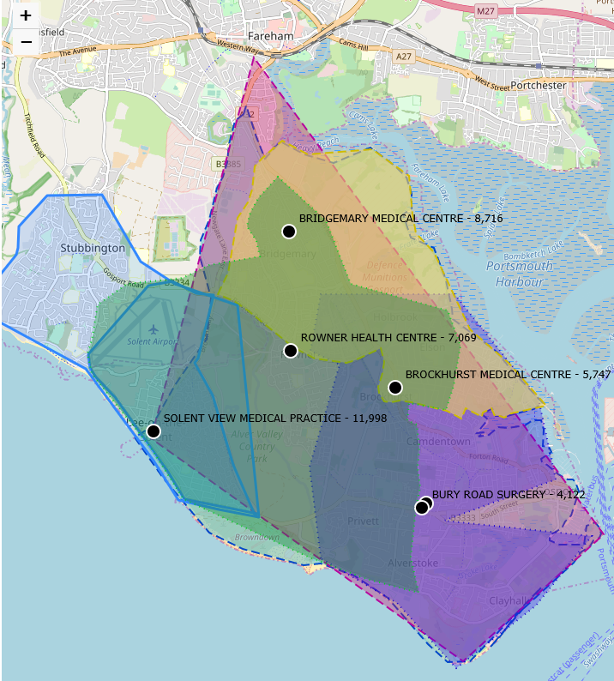
Gosport West PCN
Brockhurst Medical Centre
Bridgemary Medical Centre
Bury Road Surgery
Gosport Medical Centre
Rowner Health Centre
Solent View Medical Practice
Total list size: 47,662
Notes:
Gosport – one BOARD

Slide 10
What happens next?
2019/20 is a preparatory year
New staff groups e.g. social prescribing link workers, pharmacists
Developing extended hours

Slide 11
It would be helpful to think about…
What might the public think about Primary Care Networks?
What could be the opportunities around whole population working?
How can PPGs support this? What would be your priorities?

Slide 12
New Care Models - Transformation
Care Homes
In Fareham each care home is aligned to one Surgery
In place since 1st April 2019
Patients movement is ongoing and will naturally take place over the next year
Very well received by care home managers
Establish new ways of working (eg ward rounds)
Notes:
Previously 5 surgeries to one care home – inefficient for staff, surgeries
Multiple visit requests for visits, meds,
Care home – different surgeries and different processes for working
Letters to residents and families – patient choice remains
Ward rounds – reducing number of ad hoc calls and time spent travelling to multiple care homes

Slide 13
New Care Models - Transformation
Multi-disciplinary Team meetings (MDT)
Building on the work in 18/19 Fareham and Gosport are working towards a fully integrated MDT meeting (GP, Nurse, therapist, Social Worker and others by exception)
Virtual connectivity (tele/video-conference)
Fareham have started with 5 practices joining and plans are agreed for the other 5 to join
Gosport are planning how to integrate with the existing model at Gosport RAU
Shifting to a PCN geography representation

Slide 14
New Care Models - Transformation
Long Term Conditions
The new leg club is opening on 15th July 2019
Weekly on a Monday
Hosted at the Nimrod Community Centre
Collaboration between Community and Practice nurses
St Vincent college students will be joining in September;
Expect to develop a vibrant voluntary support system
Notes:
Purpose to reduce social isolation
Reduce leg healing times
Standardised care, working to one care plan
TVN support

